Slide 1

Shohei Ohtani’s “New Magic Ball"
Chen Wang
Fanglu Jiang
Notes:
Dear class and Dr. Cung,
Our Group 3 Project is Shohei Ohtani’s “New Magic Ball”.
Presented to you by Chen Wang and Fanny Jiang
Please sit tight and enjoy the ride.

Slide 2

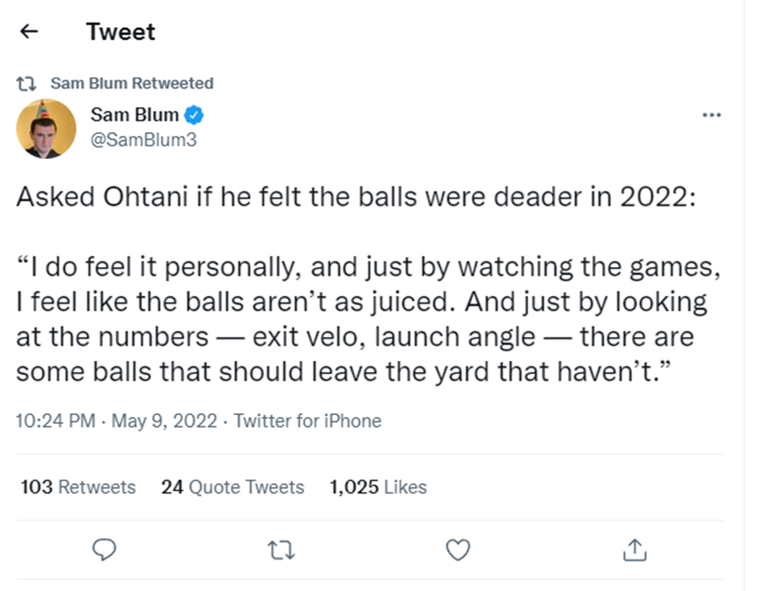
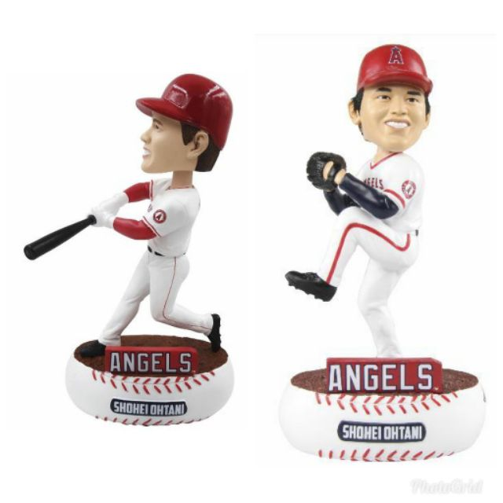
Introduction
On 5/09/2022, Ohtani responded to one of the reporters that the balls in 2022 were not as juiced
Notes:
You probably know that Shohei Ohtani, nicknamed "Showtime", is a Japanese professional baseball pitcher, good batter, designated hitter and outfielder for the Los Angeles Angels of Major League Baseball. He previously played for the Hokkaido Nippon-Ham Fighters of Nippon Professional Baseball's Pacific League. He was Born on July the 5th in 1994 (age 27 years), in Oshu, Iwate, Japan
He is 6′ 4″ tall, His Career started in 2013.This year his Salary is 5.5 million USD (2022)
His Current team is Los Angeles Angels ( he is #17 the Pitcher)
on 5/09, Ohtani responded to one of the reporters that the balls in 2022 were not as juiced. Besides, Ohtani used two terminologies to illustrate his perspectives: the exit velocity and the launch angle are different. That creates our curiosity to figure out if his casual talk was for real.

Slide 3
Research Question
Q1: Are Ohtani’s responses accurate?
Q2: Does Ohtani benefit from the balls?
Notes:
Our first research question is
Q1: Are Ohtani’s responses accurate?
If the answer is true, we will ask the second question:
Q2: Does Ohtani benefit from the balls?

Slide 4
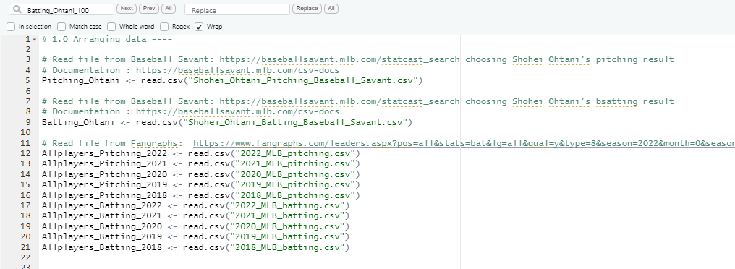
Data set and source (1)
From Baseball savant
Notes:
Let’s introduce our data first. There are two datasets for our project.

Slide 5
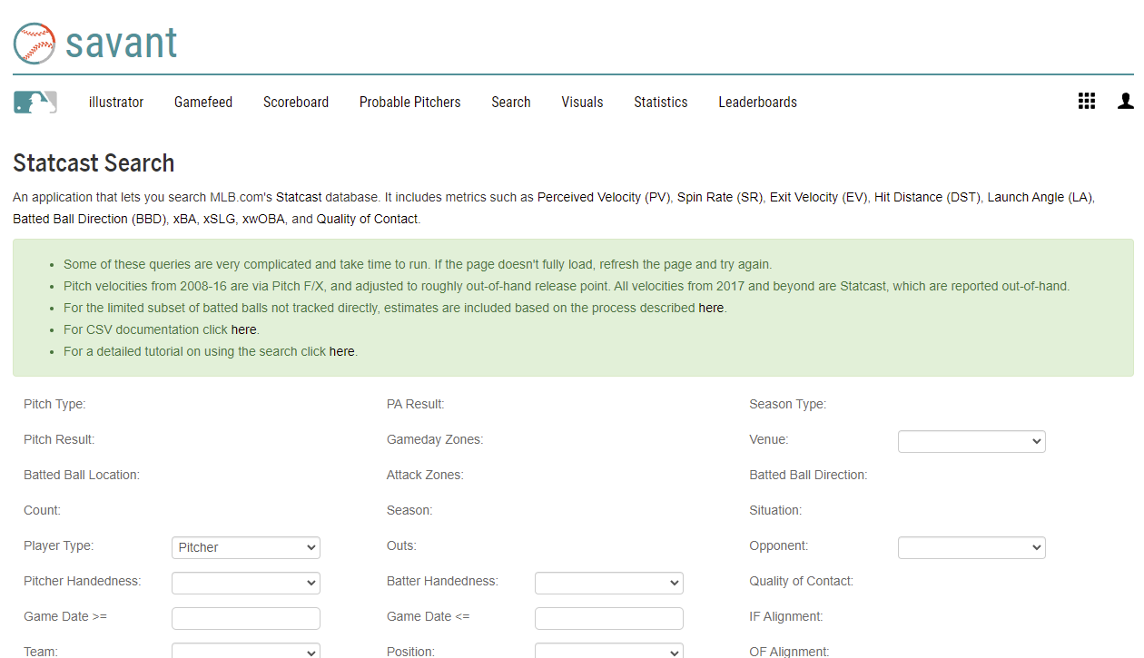
Data set and source (1)
Baseball Savant
Live data
Pitch by pitch data
Unarranged data
Pure data
Can choose by
pitchers or batters
Notes:
The first one is from Baseball Savant. It accumulates numerous data which is automatically generated by the 3D cameras. That is to say, it storages live data, pitch by pitch data, and unarranged data. Since the data is pure data, so we need to do several summarize before using it. On the website (point to the red frame), we can choose data by pitchers or by batters.

Slide 6
Introduction of Terminologies
Notes:
Let me introduce the terminology we will use in baseball savant.

Slide 7
Baseball savant key terminologies introduction (1)
Pitch type
Pitch Type Abbreviations | Classification
CH | Changeup
CU | Curveball
FA | Four-Seam
FC | Cutter
FF | Fastball
FO | Forkball
FS | Split-finger
KC | Knuckle-curve
SI | Sinker
SL | Slider
pitch_type
game_date
Date of the Game.
release_speed
Pitch velocities from 2008-16 are via Pitch F/X, and adjusted to roughly out-of-hand release point. All velocities from 2017 and beyond are Statcast, which are reported out-of-hand.
Events
Player's name tied to the event of the search.
description
Description of the resulting pitch.
Notes:
There are several different pitch types in the table. And I will use five of them in Ohtani’s data because Ohtani only uses them in his pitching. But in all MLB players, I will put them all. Game date means the date of the pitching or batter, I will extract the year only to analyze the data. Release speed means how much velocity when the ball was released from the pitchers, and the unit is mph. Events mean the final result and only be recorded only when batters finished their competition with the pitcher's at-bat, such as home run/strikeout, etc. Description records umpires’ judgments in each ball.

Slide 8
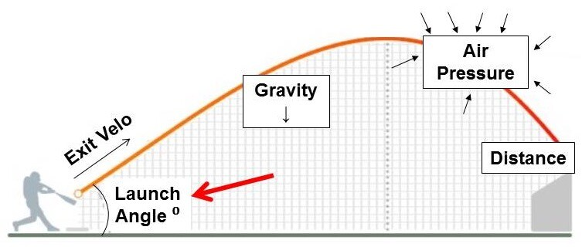
Baseball savant key terminologies introduction(2)
hit_distance
Projected hit distance of the batted ball.
launch_speed
Exit velocity of the batted ball as tracked by Statcast
launch_angle
Launch angle of the batted ball as tracked by Statcast.
Notes:
Hit distance is the ball’s landing position when the ball was hit by players, the unit is feet. Launch speed and launch angle mean the speed and the angle when batters’ hit the ball. All the three data was recorded when Events happened.

Slide 9
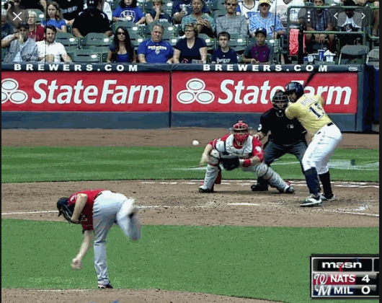
Baseball savant key terminologies introduction(3)
Baseball savant key terminologies introduction(3)
Vx0
The velocity of the pitch, in feet per second, in x-dimension, determined at y=50 feet.
Vy0
y-dimension
Vz0
z-dimension
Vz0
Release_speed
Vy0
Vx0
Notes:
Vx0, Vy0, and Vz0 means the launch speed has been separated into three dimensions. In baseball, y-axis means the pitcher toward to catcher, the z-axis points to the sky, and the x-axis point to the third base.

Slide 10
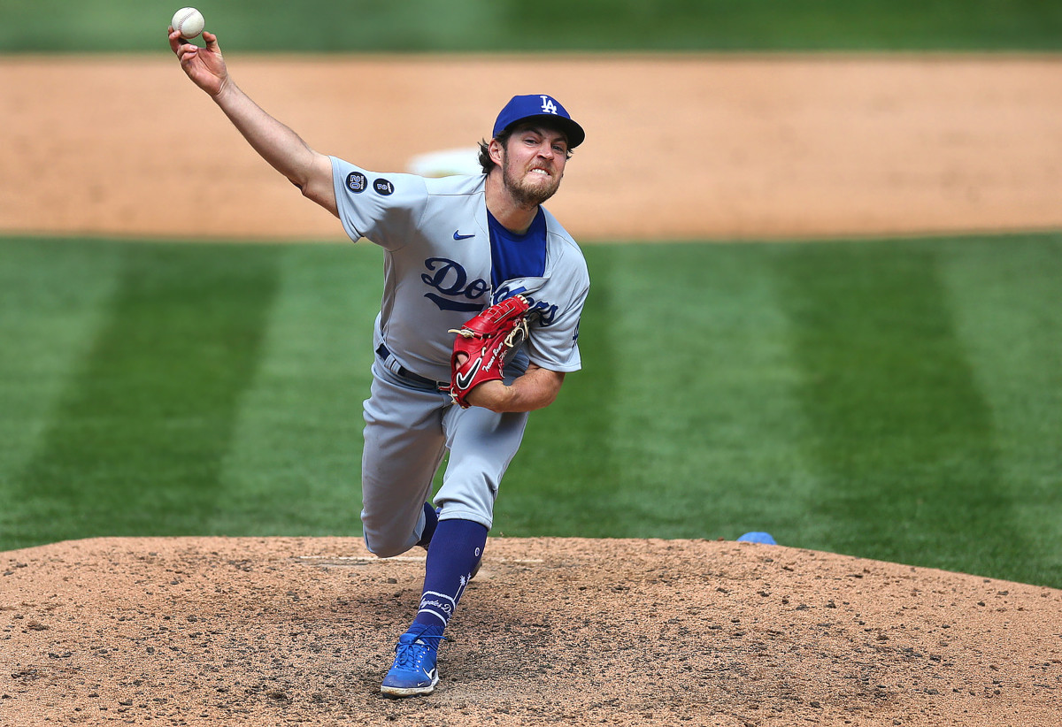
Baseball savant key terminologies introduction(4)
Release extension
Release extension of pitch in feet as tracked by Statcast.
Notes:
Release extension means the distance of the release point of the ball from the catcher. The unit is feet.

Slide 11
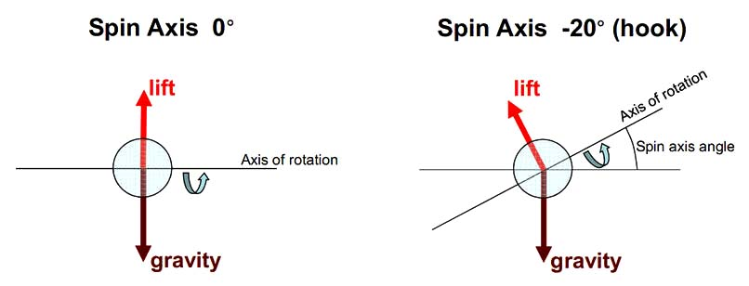
Baseball savant key terminologies introduction(5)
spin_axis
The Spin Axis in the 2D X-Z plane in degrees from 0 to 360, such that 180 represents a pure backspin fastball and 0 degrees represents a pure topspin (12-6) curveball
Notes:
Spin axis means the rotate situation (point to top curve).

Slide 12
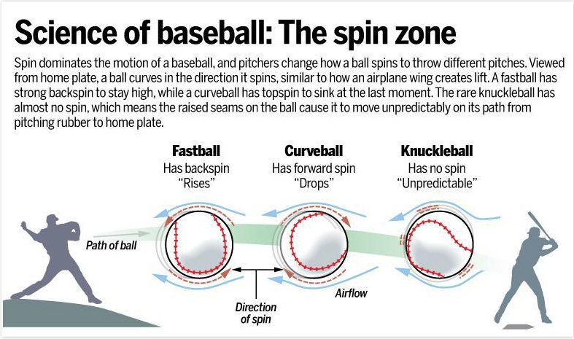
Baseball savant key terminologies introduction(6)
release_spin_rate
Spin rate of pitch tracked by Statcast.
Notes:
A pitcher's Spin Rate represents the rate of spin on a baseball after it is released. It is measured in revolutions per minute.

Slide 13
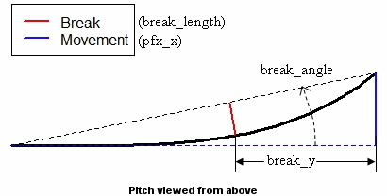
Baseball savant key terminologies introduction(7)
pfx_z
pfx_x
Pfx_x
Catcher
Pitcher
Umpire
Batter
pfx_x
Horizontal movement in feet from the catcher's perspective.
pfx_z
Vertical movement in feet from the catcher's perpsective.
Notes:
Pfx_x and pfx_z mean the horizontal and vertical movement in feet from the catcher's perspective. (point to the left curve). It’s a top view from the sky

Slide 14

Baseball savant key terminologies introduction(8)
+plate_z
plate_x
Horizontal position of the ball when it crosses home plate from the catcher's perspective.
plate_z
Vertical position of the ball when it crosses home plate from the catcher's perspective.
-plate_x
Notes:
plate_x and plate_z means at catcher’s perspective, the horizontal and the vertical position of the ball when it crosses home plate. The center is (0,0).

Slide 15
Baseball savant key terminologies introduction(9)
release_pos_x
Horizontal Release Position of the ball measured in feet from the catcher's perspective.
release_pos_z
Vertical Release Position of the ball measured in feet from the catcher's perspective.
+ Release_pos_z
- Release_pos_z
Notes:
Release_pos_x and Release_pos_x means at catcher’s perspective, the horizontal and the vertical position of the ball when it release from the pitchers

Slide 16
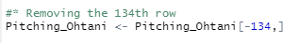
Data cleaning-From Baseball Savant
Re-naming column name
Converting to Date type
and Separating the Year
Sorting
Locating empty rows and
remove it
Notes:
There are several data cleaning processes need to be done for the dataset from the baseball savant. As we mentioned earlier, it contains unarranged data. First, I renamed the pitch type because it contains UTF-8 code, which will be a problem for future data analysis. Second, I extract the year only from the data column. Third, I sorted the dataset from the oldest to the newest. Finally, I get rid of empty rows for instances when the camera can not distinguish the pitch type.

Slide 17
Data set and source (2)
From Fangraph
Notes:
Let’s turn to the second dataset.

Slide 18
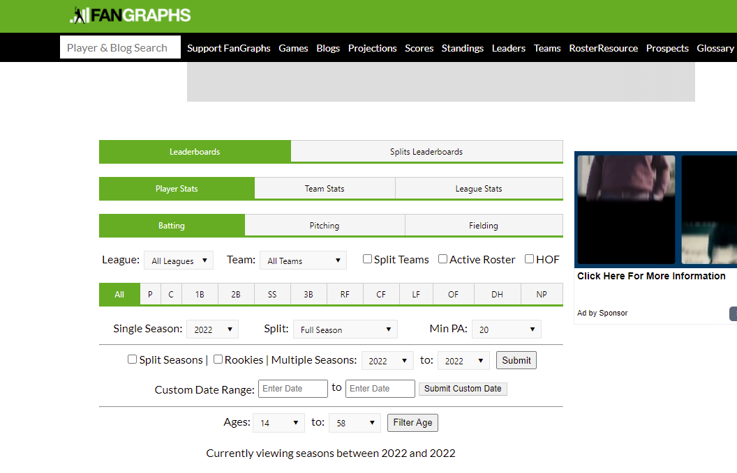
Data set and source (2)
Fangraphs
Not live data
Group by players
Post-arranged data
Calculated data
Notes:
Compared to data from baseball savant, the second one is from Fangraphs. It’s a website that provides data arranged. That is to say, it provides data from each player which was grouped by year. Also, it calculates the origin data. So, we extract the data to do a summary and calculate the average.

Slide 19
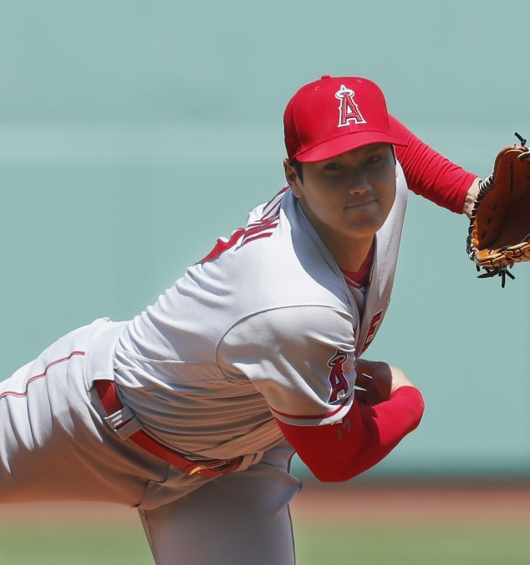
Fangraphs key terminologies introduction(1)
ERA: Earned Run Average
K.9: Strike Out per 9 innings
BB.9: Walks per 9 innings
WAR: Wins Above Replacement
HR/FB: Home Run/Fly ball
Notes:
Let us introduce the terminology we will use in Fangraphs. ERA means earned Run Average, it also is grouped by pitchers or a team. K/9 means how many average strikes out a pitcher can strike in 9 innings. BB/9 means how many walks a pitcher performs in 9 innings. All the above are the variables that we will always see on news or on TV. WAR means wins above replacement. HR/FB means total home runs divided by total fly balls, it’s always a point to illustrate a team or a batter’s power.

Slide 20
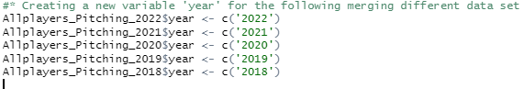
Data cleaning-From Fangraphs
Creating a variable ‘year’
Re-naming column name
Merging different years’ dataset
Notes:
There are only a few data cleanings to be done in the post-arranged dataset. Extracting the ‘year’, re-naming, and Merging different years’ datasets into one.

Slide 21
Summary statistics
Notes:
Let’s move on to summary statistics

Slide 22

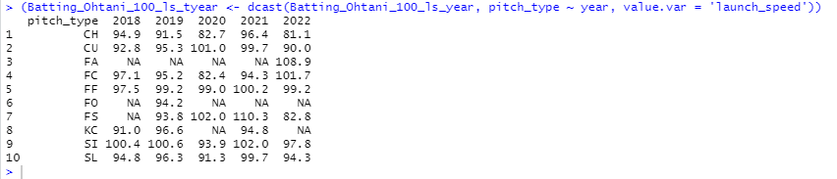
Ohtani’s exit velocity by different types
pitch_type | 2018 | 2019 | 2020 | 2021 | 2022
Changeup | 94.9 | 91.9 | 82.7 | 96 | 81.1
Curveball | 92.8 | 95.3 | 101 | 99.7 | 90
Four-Seam |  |  |  |  | 108.9
Cutter | 97.1 | 95.2 | 82.4 | 94.3 | 101.7
Fastball | 97.5 | 99.2 | 99 | 100.2 | 99.2
Forkball |  | 94.2
Split-finger |  | 93.8 | 102 | 110.3 | 82.8
Knuckle-curve | 91 | 96.6 |  | 94.8
Sinker | 100.4 | 100.6 | 93.9 | 102 | 97.8
Slider | 94.8 | 96.3 | 91.3 | 99.4 | 94.3
Notes:
There are several summary statistics, but I only include three of them. The first is I use the aggregate function to calculate the exit velocity from Ohtani’s batting, then use the dcast function to melt ‘year’ into column names.

Slide 23
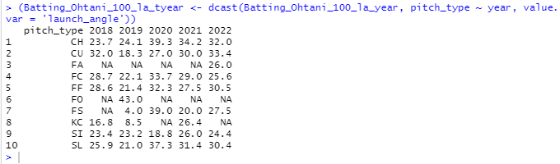
Ohtani’s launch angle by different types
pitch_type | 2018 | 2019 | 2020 | 2021 | 2022
Changeup | 23.7 | 23.3 | 39.3 | 35.1 | 32
Curveball | 32 | 18.3 | 27 | 30 | 33.4
Four-Seam |  |  |  |  | 26
Cutter | 28.7 | 22.1 | 33.7 | 29 | 25.6
Fastball | 28.6 | 21.4 | 32.3 | 27.1 | 30.5
Forkball |  | 43
Split-finger |  | 4 | 39 | 20 | 27.5
Knuckle-curve | 16.8 | 8.5 |  | 26.4
Sinker | 23.4 | 23.2 | 18.8 | 26 | 24.4
Slider | 25.9 | 21 | 37.3 | 30.9 | 30.4
Notes:
The second one is almost the same as the first one, but in this case, I change the variables from exit velocity to launch angle.

Slide 24

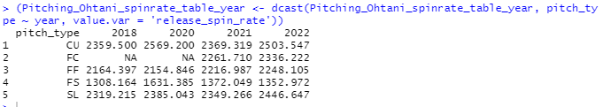
Ohtani’s spin rate by different years
pitch_type | 2018 | 2020 | 2021 | 2022
Curveball | 2359.5 | 2569.2 | 2369.3 | 2503.5
Cutter |  |  | 2261.7 | 2336.2
Fastball | 2164.4 | 2154.8 | 2217.0 | 2248.1
Split-finger | 1308.2 | 1631.4 | 1372.0 | 1353.0
Slider | 2319.2 | 2385.0 | 2349.3 | 2446.6
Notes:
The third one is I aggregate the Ohtani’s average spin rate in different pitch types and different years.

Slide 25
Result and findings
Notes:
Let’s move on to the result and findings.

Slide 26
Q1: Is Ohtani’s responses accurate?
Notes:
Let’s review our initial question again, Are Ohtani’s responses accurate?

Slide 27
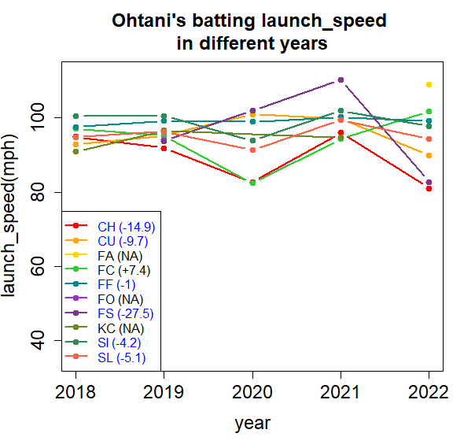
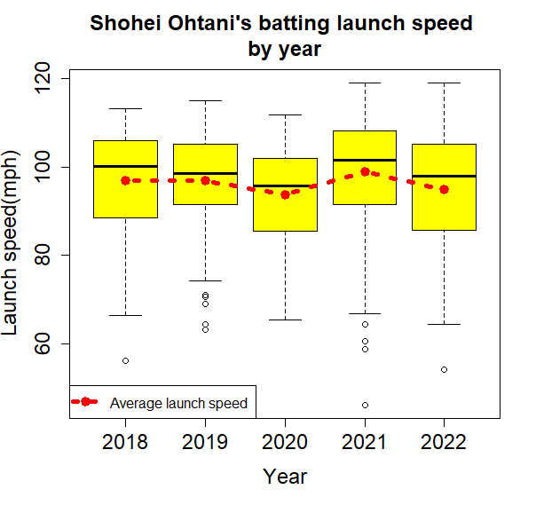
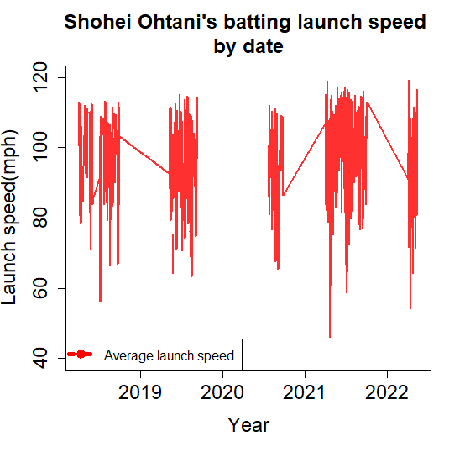
Launch speed (Exit velocity) scatter plot (average)
pitch_type | 2018 | 2019 | 2020 | 2021 | 2022
Changeup | 94.9 | 91.9 | 82.7 | 96 | 81.1
Curveball | 92.8 | 95.3 | 101 | 99.7 | 90
Four-Seam |  |  |  |  | 108.9
Cutter | 97.1 | 95.2 | 82.4 | 94.3 | 101.7
Fastball | 97.5 | 99.2 | 99 | 100.2 | 99.2
Forkball |  | 94.2
Split-finger |  | 93.8 | 102 | 110.3 | 82.8
Knuckle-curve | 91 | 96.6 |  | 94.8
Sinker | 100.4 | 100.6 | 93.9 | 102 | 97.8
Slider | 94.8 | 96.3 | 91.3 | 99.4 | 94.3
2022’s average launch angle drop
Mean/median drop
Sd keep
Notes:
When I plot the exit velocity in different types for different years, the plot again shows us that most lines dropped in 2022. the plot illustrates in fastball in purple( points to the purple color) and in changeup in red(the red color), the launch speed dropped dramatically. That meets Ohtani’s anticipation because Fastball is easier hit and then produces a long play.

Slide 28
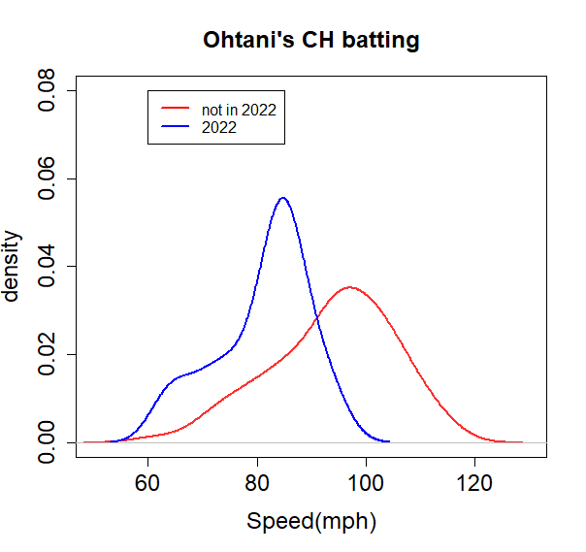
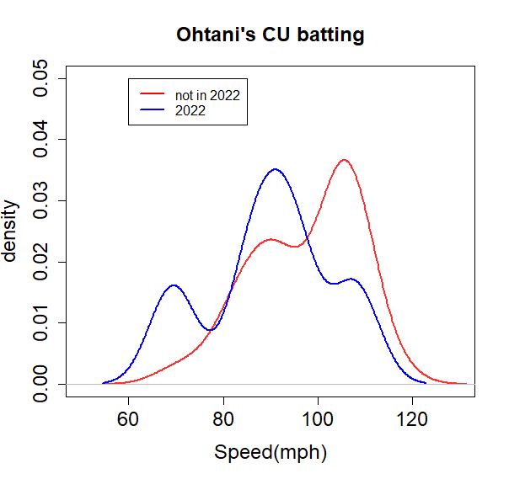
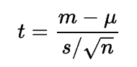
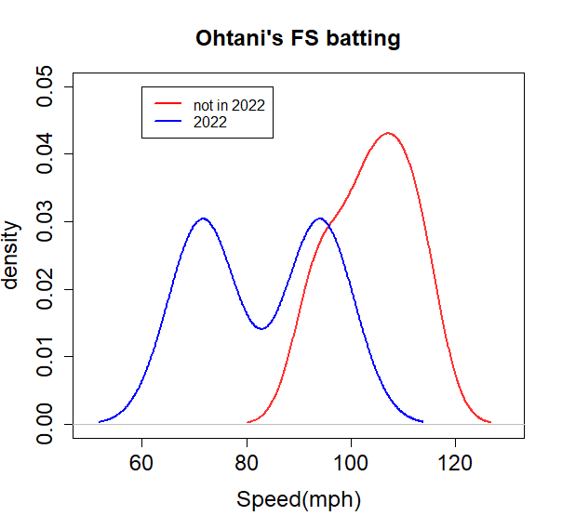
pitch_type | Previous (mph) | 2022 | P-value | t
 |  | (mph)
Changeup (CH) | 81.144 | 93.82 | 0.002 | -3.99
Curveball (CU) | 89.98 | 97.515 | 0.307 | -1.15
Split-finger (FS) | 82.85 | 104.1 | 0.284 | -1.77
Pitch type /stand deviations | Previous (mph) | 2022
Changeup | 11.5 | 8.8
Curveball | 11.3 | 14.2
Four-Seam
Cutter | 14.6 | 8.4
Fastball | 11 | 13.6
Forkball
Split-finger | 8.2 | 15.9
Knuckle-curve | 7.8
Sinker | 13.3 | 12.1
Slider | 11.6 | 10.8
More counts and smaller s→ higher t → smaller P
Keep tracing until sd is stable!! (count too low)
Back to the
revision page

Slide 29
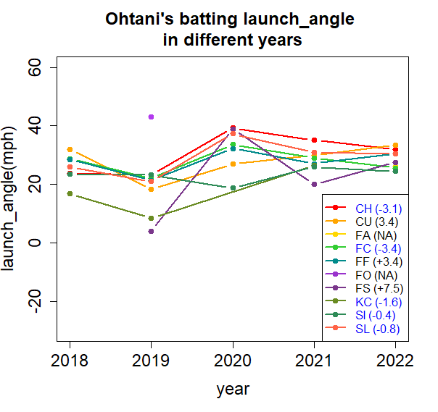
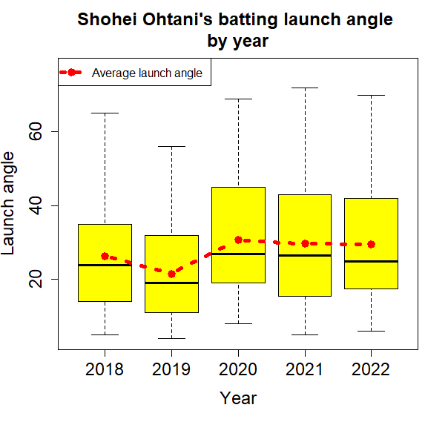
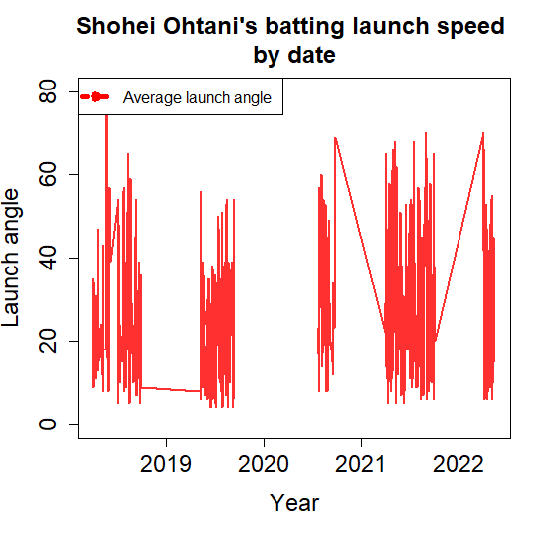
Launch angle scatter plot(average)
pitch_type | 2018 | 2019 | 2020 | 2021 | 2022
Changeup | 29.7 | 28.6 | 43.3 | 38.6 | 32.9
Curveball | 34.4 | 23.8 | 33 | 36.5 | 33.5
Four-Seam |  |  |  |  | 26
Cutter | 31.1 | 28.2 | 40.6 | 36.5 | 29.8
Fastball | 32.9 | 28 | 45.2 | 37.3 | 35.9
Forkball |  | 43
Split-finger |  | 30.5 | 52.5 | 20.7 | 37
Knuckle-curve | 27.2 | 8.5 | 43 | 30.8 | 56
Sinker | 28.2 | 28 | 25.3 | 34.1 | 29.8
Slider | 29.1 | 25.5 | 37.8 | 37.7 | 36.9
2022’s average launch angle slightly drop
Mean/median
Almost the same
Sd keep
Notes:
When the launch angle was plotted in different types for different years, the differences are clearer.
However, the result is 50/50 and we can hardly predict a trend from the launch angle.

Slide 30
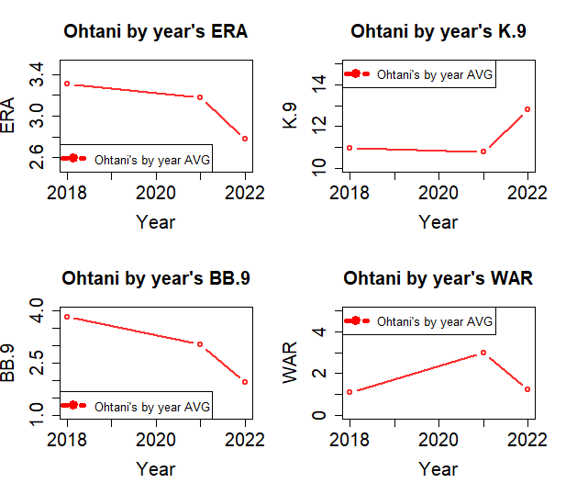
Ohtani’s pitching result
All performance is better from previous.
WHY?
Notes:
Based on our research, the launch speed of the Ohtani’s hit increased dramatically. A question is raised: Is Ohtani’s pitching get better? From Ohtani’s pitching result, We can see ERA, WAR, and BB/9, K9 are all better than in 2021. Our curiosity leading us to more research.

Slide 31
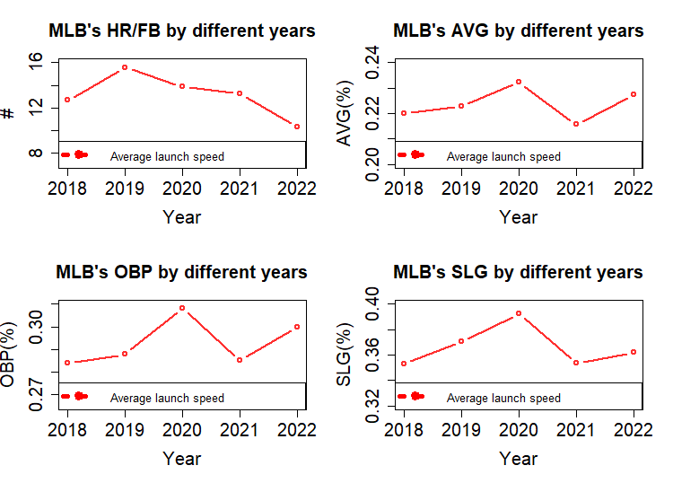
MLB player’s average batting
HR/FB is at low side.
WHY?
Notes:
We checked the HR/FB in all MLB players with total PA>20 in 2022, and PA>50 in other years, the HR/FB actually has dropped in 2022, but the AVG/OBP/SLG do not have the same trend. AVG/OBP/SLG may be affected by different factors though. So, I decided to thoroughly analyze Ohtani’s pitching to see if the balls have influenced by Ohtani.

Slide 32
Short Conclusion 1
Q1: Are Ohtani’s responses accurate?
A1:
The balls in 2022 are not as juiced only in launch speed, but are not obvious at launch angle
T- test shows not all pitch type of batting have very low P-value (insignificant), should trace more data ( sd should be stable)
HR/FB shows MLB batters are struggling now → impling the flexibility is lower now (not juiced)
Notes:
Our short conclusion for question1 is “Yes, the balls in 2022 are not as juiced.”

Slide 33
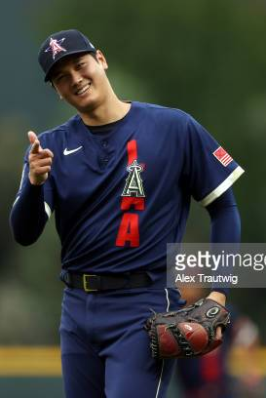
Q2: Does Ohtani benefit from the balls?
Notes:
SO, we want to check Does Ohtani’s pitching benefit from the balls?

Slide 34
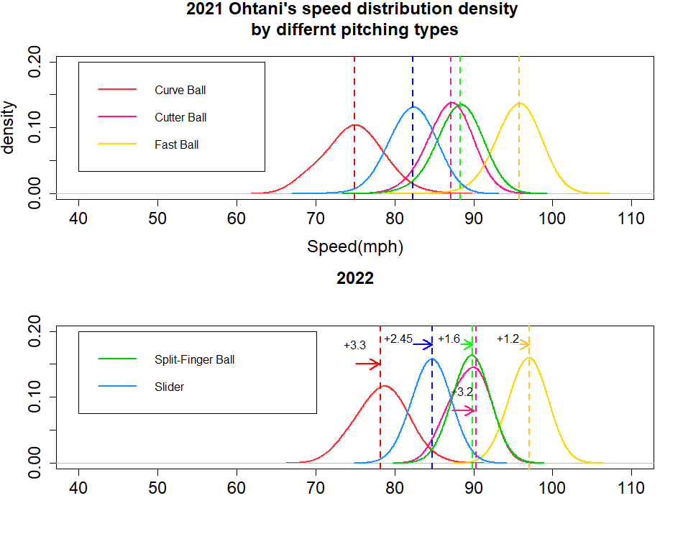
Release speed from Ohtani’s pitching
All 5 balls’ speed increase in 2022
Notes:
First, we checked the release speed for the five types’ pitching. The result is obvious: all the five types of pitching have a significant increase because the median shift from the left to the right in the density plot.

Slide 35
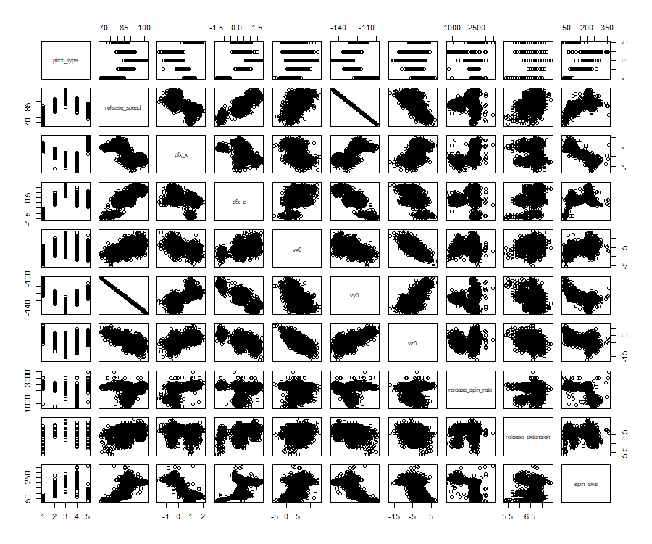
Overall of Ohtani’s pitching
Notes:
Second, even though speed is not a good indicator factor to judge pitching’s quality, I still want to check the scatter plot between release speed and others. In this scatter plot, there are five pitching types, which cause obvious clusters in some plots. Such as pfx_z v.s release speed (point to release speed to pfx_z), so I want to check the scatter by keeping in one pitching type.

Slide 36
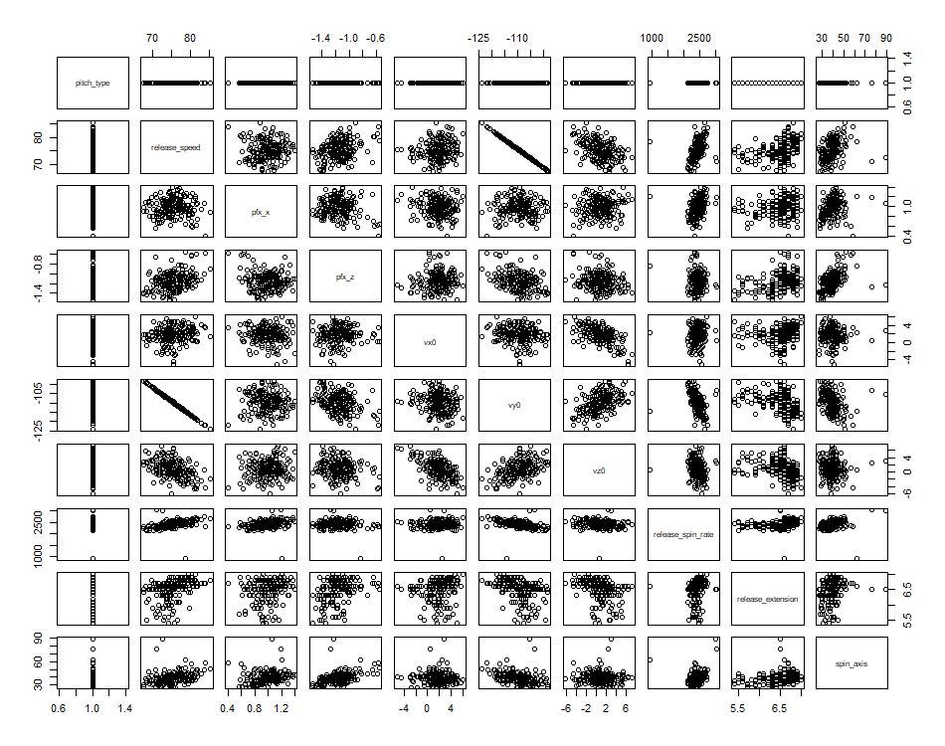

Curveball of Ohtani’s pitching
Notes:
When I eliminated Curve ball data, the cluster disappeared. It made perfect sense that vy0 is highly correlated with release speed, as I have mentioned previously that vy0 is the velocity towards the catcher.

Slide 37
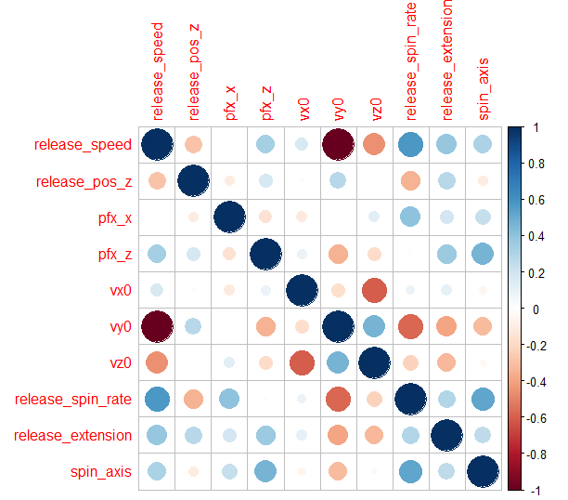
Correlation
Release speed = Vx0i +Vy0j + Vz0k
Notes:
We tried to draw a correlation plot. Unless Vy0, Vx0, and Vz0 also have medium-high correlation. But again, it made sense that Vy0 and Vz0 are highly correlated because release velocity would be divided into Vx0, Vy0, and Vz0. Also, there is a medium-high correlation between spin rate and release speed.

Slide 38
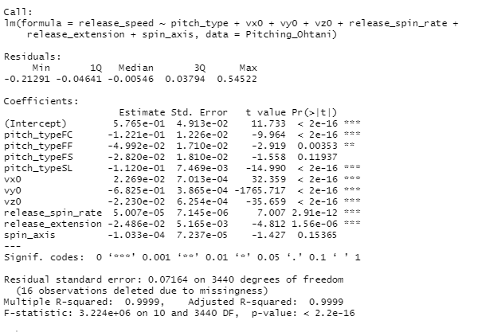
Linear regression
Release speed correlated with most variables except Curveball, spin_axis
Release speed = 0.5765 -0.1221* Cutter - 0.04992*Fast – 0.112*Slider -0.0269*Vx0 -0.6825*Vy0 -0.023*Vz0 -0.00005*spin rate -0.02486*release extension
Notes:
In the linear regression table, except the pitch type is Split-finger and the spin axis, the overall P-value is less than 0.05, which means it is predictable. If we exclude the P-value larger than 0.05 variables, the final regression line would be Release speed = 0.5765 -0.1221* Cutter - 0.04992*Fast – 0.112*Slider -0.0269*Vx0 -0.6825*Vy0 -0.023*Vz0 -0.00005*spin rate -0.02486*release extension.

Slide 39
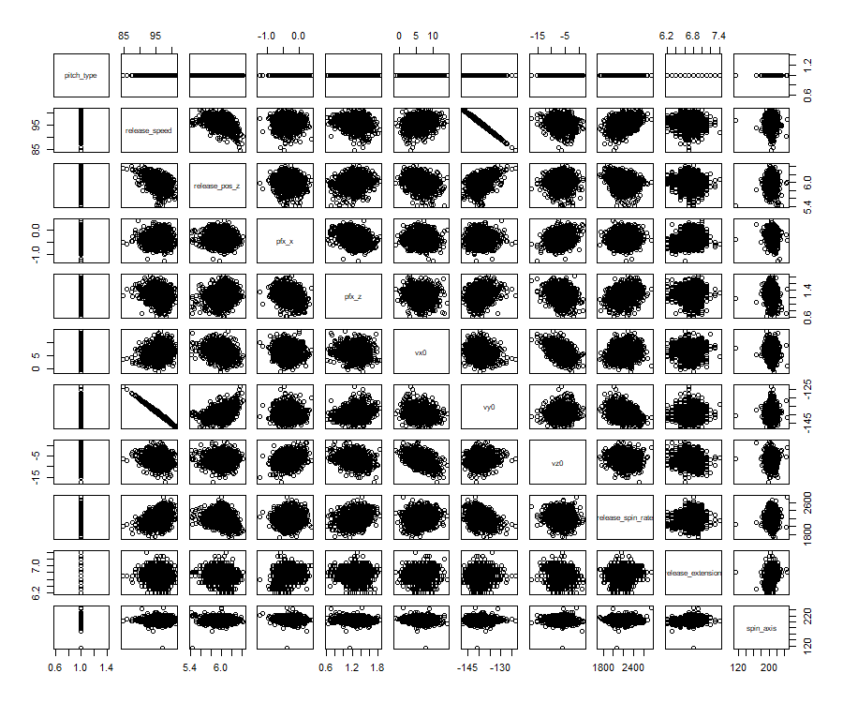
Fast ball of Ohtani’s pitching
Correlation low with others
Notes:
If we check the plot between fast to others, it would be more obvious that spin axis(point to spin axis) has no correlation to release speed because no matter how much is the release speed, the spin axis keeps at the same range.

Slide 40
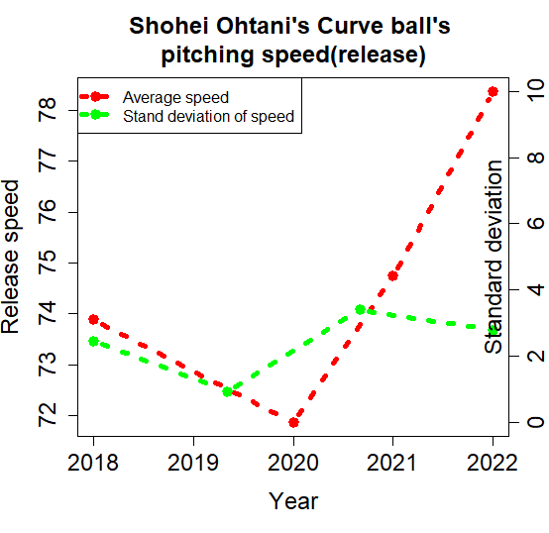
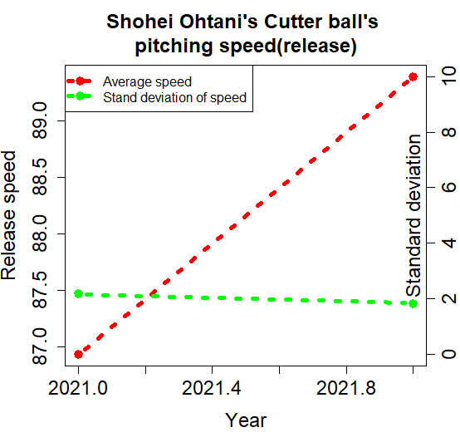
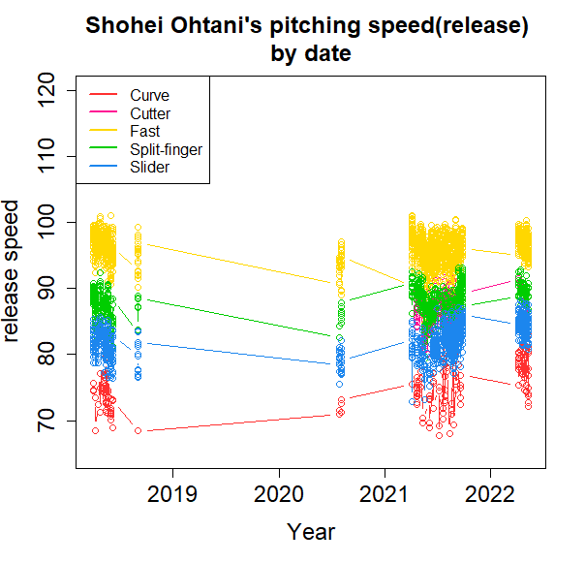
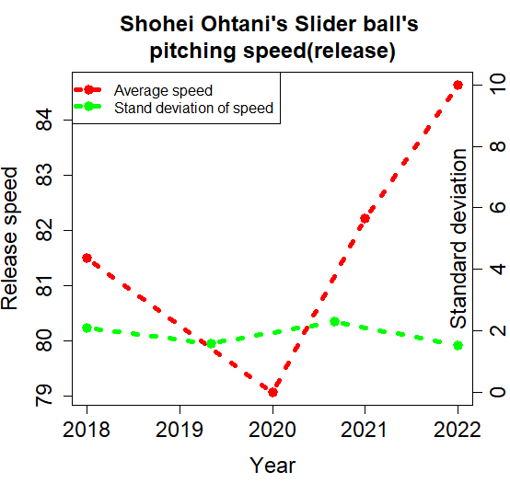
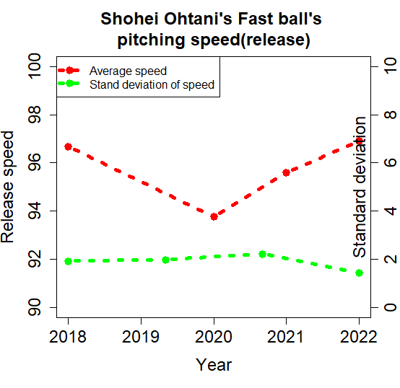
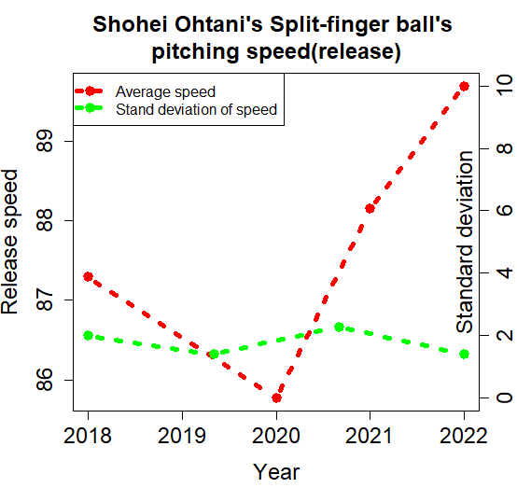
Launch speed by year plot
All pitching are faster
Notes:
Hence, I wanted to check the scatter plot by year and group by pitch type to see if there were something hidden that I haven’t discovered. First of all, I draw a plot that I have already known the result of, the speed is faster this year. I double-checked the standard deviation (green line at the right five plots) in 2022 and found that it is stable.

Slide 41
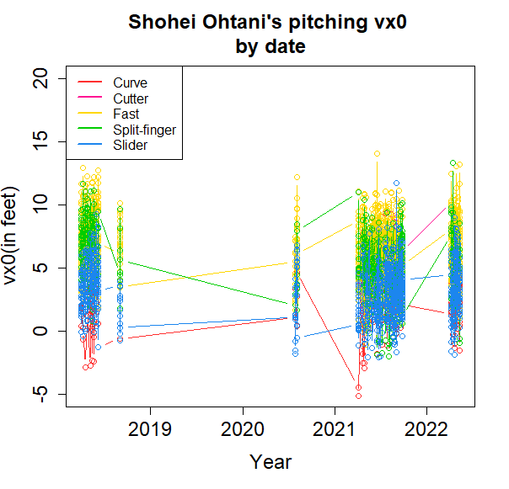
Vx0 by year plot
Vz0
Release_speed
Vy0
Vx0
No obvious found
Notes:
Second, we checked the Vx0 and found the deviation is stable. It did not have an obvious change.

Slide 42
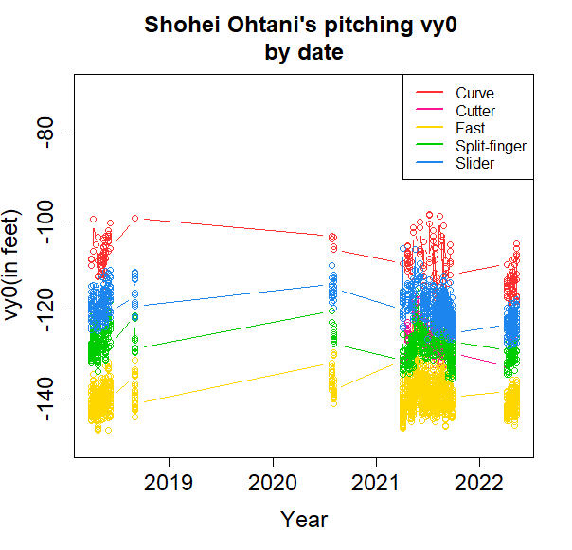
Vy0 by year plot
Vz0
Release_speed
Vy0
Vx0
Vy0 is faster!! (more negative)→ faster release speed!!
Notes:
Third, the Vy0 is faster (more negative in each type). The result again confirms our previous finding.

Slide 43
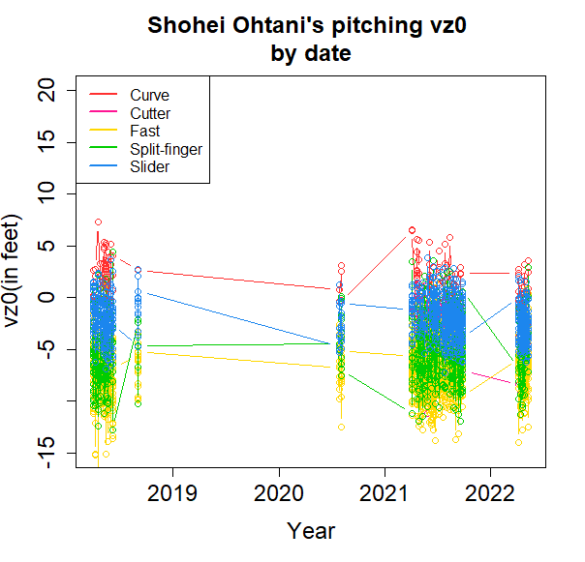
Vz0 by year plot
Vz0
Release_speed
Vy0
Vx0
No change
Notes:
The Vz0 is stable.

Slide 44
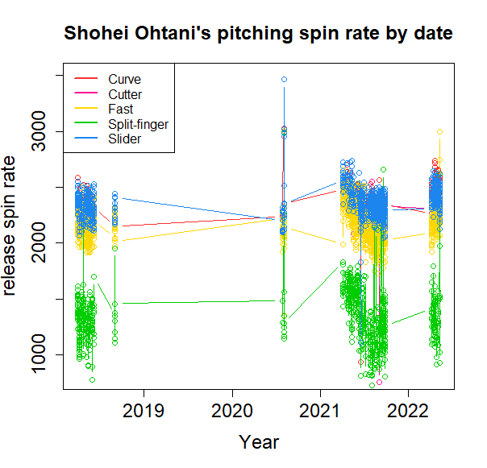
Spin rate by year plot
Still follow the pattern even though the average is higher now.
pitch_type | 2018 | 2020 | 2021 | 2022
Curveball | 2359.5 | 2569.2 | 2369.3 | 2503.5
Cutter |  |  | 2261.7 | 2336.2
Fastball | 2164.4 | 2154.8 | 2217.0 | 2248.1
Split-finger | 1308.2 | 1631.4 | 1372.0 | 1353.0
Slider | 2319.2 | 2385.0 | 2349.3 | 2446.6
Notes:
The spin rate plot is interesting. When we aggregated the table, it tells us that the spin rate is higher this year, but when we check the chronological pitching, we found that in 2021, the spin rate was trending down as time passed. So even if the spin rate is high now, it does not mean Ohtani has a higher spin rate this year. We should thoroughly check each graph before making any conclusion, or we would make mistake.

Slide 45
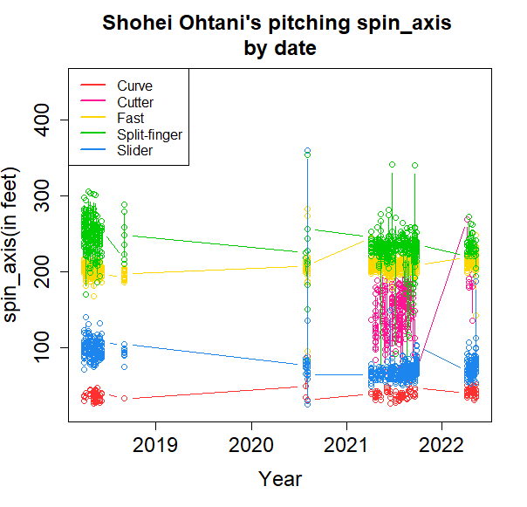
Spin axis by year plot
No change
Notes:
Spin axis is the same, no difference

Slide 46
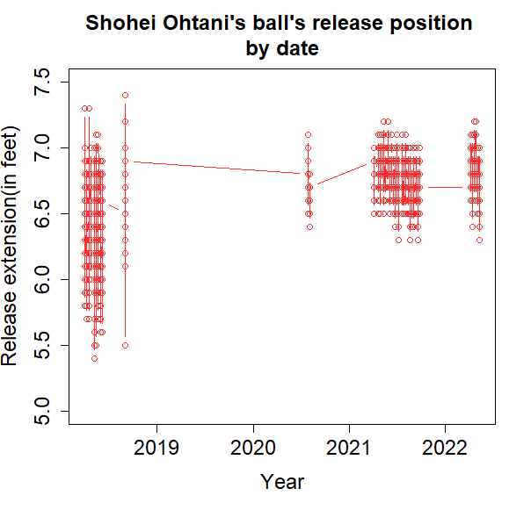
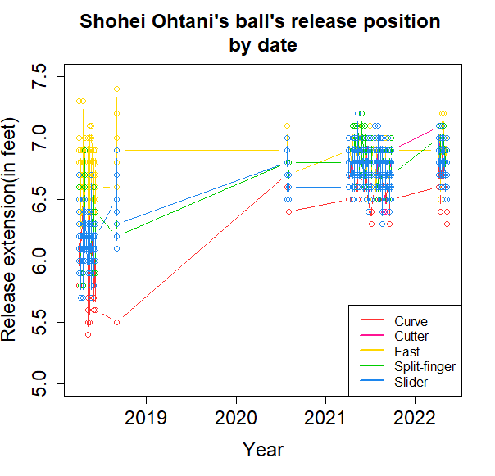
Release ball’s position to Homeplate by year plot
Are not stable at
different pitch types
2018’s pitching can be guessed by MLB players→ performance (ERA) is higher
Notes:
When I checked the release extension curve by year only, I got an interesting finding. The standard deviation in 2018 was obviously higher than others. When I tweak further by separating it into different pitch types, I found Ohtani’s releasing extensions are unstable. It’s a new story for me and I had not ever read any research about this before.

Slide 47
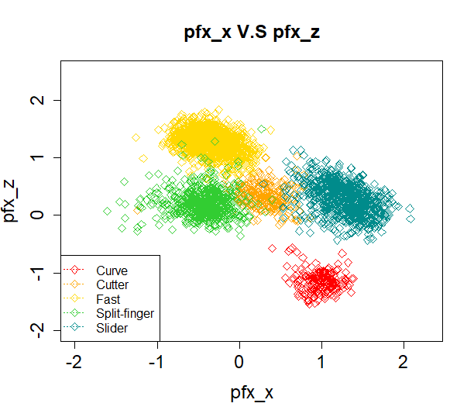
Pfx_x V.S. pfx_z
Catcher
Pitcher
Umpire
Batter
+pfx_z
-pfx_x
Pfx’s movement becomes clusters
Notes:
When I used horizontal movement(pfx_x) to plot with the vertical movement(pfx_z), there are some obvious differences in different pitch types. For example, the fastball is always at the high side, the curveball is always at the downside. However, it is still difficult to check the quality between this year and other years. I decided to test them by different years.

Slide 48

Release_pos_x V.S release_pos_z
+ Release_pos_z
- Release_pos_z
Release_pos_x left shift
Ohtani still modifies his pitching gesture!!
Notes:
However, when I checked the release_pos_x V.S release pos_z, the chart tells me something different. Compared to 2021’s chart, in 2022, the release_pos_x slightly shift left, which is almost the same as 2018’s. This means that Ohtani tries to roll back to 2018’s gesture but keeps the same release extension.

Slide 49

Short Conclusion 2
Q2: Does Ohtani benefit from the flexible ball?
A2: Maybe, but Ohtani has higher speed, more stable release, and slightly modifies his gestures→ better AVG
Notes:
Our conclusion to question 2 is Maybe. Ohtani’s pitching has a better quality, but in fact, he still tries to adjust his release point while pitching. He tries to release his ball at the same position while pitching different types of ball. That’s why his ERA becomes better and better now.

Slide 50
Final Conclusions
The balls in 2022 are not as juiced
HR/FB trends down
Ohtani’s batting exit velocity and launch angle also trends down
Ohtani keeps improving his ERA
Ohtani’s pitching position roll back to the same as 2018, but did not change while pitching different types of ball, and have better release speed→better ERA
Notes:
Let me summarize our conclusions. First, the balls are not as juiced because Ohtani’s launch speed of pitching, launch angle of pitching, and MLB players’ HR/FB (home run/high ball) are all trending down. Second, he is faster in released speed, and rollback release position to the same as in 2018 but did not change while pitching different types of ball, which makes him to have a better ERA.

Slide 51

Future Steps
Creating automatically streamlines for each player, not only for one specified players→ save time
Creating visualization plots combined with a zone map
Notes:
Here are my future steps. First of all, to shorten the coding time, I consider to create a streamline for each player, which means, if I put a dataset in the file, I execute the data, then I can finish all the work, including pictures storing. I want to analyze by zones pitching performance, but the baseball map is irregular, I need to try different methods to fill in the zone, such as dot, average, or any numbers calculated from the aggregation function.
This concludes our presentation. We hope you found it interesting as well.

Slide 52
Feedback
Notes:
Let’s move on to summary statistics

Slide 53
Revision 1
YUNG-CHING LIN
I really enjoyed viewing the presentation slides, which were very informative and educative about the baseball pitching stats. I found it very descriptive and insightful when viewing the release speeds data of a variety of pitching types were laid out in a single density plot of "Release speed from Ohtani's pitching". In addition, the ball movement evidence you found in the scatter plot of "Pfx_x v.s pfx_z" was intriguing to me, which could be regarded as another research topic. However, I would suggest considering symbols (type = "b") with data point info with some of your time series plots instead of line charts (type = "l"). Several intermittent or irregular fluctuations in your line charts might've confounded the audience when there's no further info to explain the phenomenon.
Feedback
It looks the same in visualization. But I still welcome to revise them.

Slide 54


Feedback
Before | After
P40~P46

Slide 55
Revision 2
Ally Hayashi
I liked the plot showing the break and movement of each pitch. It is interesting to see that some of the split finger pitches overlap with the fast pitch.
Depending if the information is available, it would be interesting to see a scatter plot of all the pitches differentiated by color comparing release speed and if the ball was hit.
Feedback
No need to revise though.

Slide 56
Revision 3
Haledim Kim
The visuals showing Ohtani’s ERA, K/9, BB/9, WAR across the years was the easiest to read and showed that there is indeed significant change in Ohtani’s performance as a pitcher in 2022. Since exit velocity and launch angles of balls are lower than previous year, that should prevent the number of runs being scored and thus improving the pitcher’s stats. The only thing I’d suggest is in the second part of the presentation discussing the second research question, if the result/findings from different types of pitches were insignificant it might’ve been better to use less slides to report the findings instead of dedicating individual slides for all of them (style preference). It just felt like there were way too many visuals that were being thrown at me and they started to look similar and it could be consolidated and condensed.
Feedback
I put them into the back up slides.

Slide 57


Feedback
Before | After
Shortening the second part to 15 pages. No conclusion pages were put into the backup slides

Slide 58
Revision 4
Fanny Jiang
This project is a good education of baseball, the conclusion is insightful, an eye opener. I am grateful to participate in this group. The coding is not legible and could be eliminated.
Feedback
No suggestion.

Slide 59
Revision 5
Eric Gourlaouen
I thought this presentation was entertaining and compelling - it was a great research question! The data was very well presented. I particularly liked the box plots, such as the one that showed evolution of launch speed over time. I thought that the added layers and notes on-top of the box plots were very helpful to convey the message.
For the model that you build, a multi-dimensional graph could have been a good idea to try and represent the model.
Feedback
3D plot is fashionable but is unrecognizable. I avoid using them in daily analysis.

Slide 60


Feedback
3D plot 1 (Vx0-Vy0-Vz0) | 3D plot 2 (Vx0-Vy0-Vz0)
Vz0
Release_speed
Vy0
Vx0
3D plot is fashionable but is unrecognizable. As a result, I avoid using them in daily analysis.

Slide 61
Revision 6
Zihe Tang
Thanks so much for a complete introduction to Shohei Ohtani! I really like the two launch speed scatter plots. They demonstrate the changing trend of the variables over the years. However, when it comes to the ball's release position plot and the spin-axis plot, the line charts are a little bit to follow.
Feedback
The variables release_pos_x and release_pos_z are very difficult to understand. Thus, I have put some wordings on the slides and the following slides.

Slide 62


Feedback
Before | After
Adding some notes to auxiliary help reading.

Slide 63
Revision 7
Stephanie Jaquez
Interesting topic. I enjoyed many portions of the presentation, especially the outlining of data you wanted to point out. I also enjoyed the clear detailed scatterplot (43) indicating the variables for Launch Speed by year. I liked that you graphed each pitch separately to determine if there was a change and depict any obvious changes. My only suggestion is not related to visual but to explanation of common baseball terms for those of us who did not know what ‘juiced baseball’ referred to.
Feedback
Most of the variables are profound for beginner at baseball. Even though I consider I have watched baseball games for more than 17 years, some of them I have never heard before. I have put all the definitions into the slides.

Slide 64


Feedback
Before | After
Adding definition into page 7~15, 18, 19

Slide 65
Revision
Notes:
Let’s move on to summary statistics

Slide 66
Revision

Slide 67
BACK UP
Notes:
Let’s move on to summary statistics

Slide 68

CU’s Pfx_x V.S. pfx_z
Catcher
Pitcher
Umpire
Batter
+pfx_z
-pfx_x
Nothing special
Notes:
The curveball can not tell me any differences, especially in 2022. (keep 5 seconds)

Slide 69

FCPfx_x V.S. pfx_z
Catcher
Pitcher
Umpire
Batter
+pfx_z
-pfx_x
Nothing special
Notes:
The Cutter ball can not tell me any difference either, especially in 2022. (keep 5 seconds)

Slide 70

FF’s Pfx_x V.S. pfx_z
Catcher
Pitcher
Umpire
Batter
+pfx_z
-pfx_x
Nothing special
Notes:
Fastball is also the same. (keep 5 seconds)

Slide 71

FS’s Pfx_x V.S. pfx_z
Catcher
Pitcher
Umpire
Batter
+pfx_z
-pfx_x
Nothing special
Notes:
Split-finger is also the same. (keep 5 seconds)

Slide 72

SL’s Pfx_x V.S. pfx_z
Catcher
Pitcher
Umpire
Batter
+pfx_z
-pfx_x
Nothing special
Notes:
The slider is also the same. (keep 5 seconds)

Slide 73

Plate_x V.S. plate_z
+plate_z
-plate_x
2018 can be guessed by MLB players
Notes:
When I used plate_x and plate_z to draw a scatter plot, it didn’t tell me much.

Slide 74

CU’s Plate_x V.S. plate_z
+plate_z
-plate_x
Nothing special
Notes:
Even when I have separated them by different years, the result is the same. (keep 5 seconds)

Slide 75

FC’s Plate_x V.S. plate_z
+plate_z
-plate_x
Nothing special
Notes:
Cutter ball. (keep 5 seconds)

Slide 76

FF’s Plate_x V.S. plate_z
+plate_z
-plate_x
Nothing special
Notes:
Fast ball. (keep 5 seconds)

Slide 77

FS’s Plate_x V.S. plate_z
+plate_z
-plate_x
Nothing special
Notes:
Split finger. (keep 5 seconds)

Slide 78

SL’s Plate_x V.S. plate_z
+plate_z
-plate_x
Nothing special
Notes:
Slider. (keep 5 seconds)

